Slide 1

Mini Project Abstract Presentation
Lora Based Multihop Predictive Energy Demand Modelling For Wireless Communication Networks
student details:
1. N.Varshika(23C31A04C4)
2. V.Ravi Vardhan(23C31A04H1)
3. S.Sharavana (23C31A04G0)
4. S.Ravalika(23C31A04F4)
5. P.Srinivas(23C31A04E3)
Supervisor Details:-
Gatla.Sandeep
Assistant professor

Slide 2
Abstract:-
This project proposes a LoRa-based multihop wireless communication system integrated with predictive energy demand modelling.Machine learning algorithms are used to predict the future energy demand of wireless sensor nodes.Based on this prediction, the system can support energy-aware routing decisions.The proposed approach helps improve network lifetime, scalability, reliability, and overall energy efficiency in wireless communication networks.
LoRa (Long Range) communication is widely used in low-power wide-area networks (LPWAN) for IoT applications.The system enhances energy efficiency in wireless sensor networks (WSNs). Predictive algorithms estimate future energy requirements to enable optimized routing and transmission.

Slide 3
Problem Statement:-
Traditional wireless sensor networks suffer from high energy consumption, limited communication range, and poor scalability.
In single-hop LoRa communication, nodes far from the gateway consume excessive power due to long-distance transmission.
Existing systems do not predict future energy demand, which leads to inefficient routing and reduced network lifetime.
Therefore, there is a need for predictive and energy-aware multihop communication.

Slide 4
Literature Survey:-
From literature review, we found that most existing LoRa systems use single-hop communication.
Traditional routing protocols are static and do not consider predictive energy optimization.
Several IoT research works use machine learning for forecasting and optimization.
However, limited work combines LoRa multihop communication with predictive machine learning models for energy-aware routing.

Slide 5
Objectives:-
->The objectives of our project are:
First, to develop a LoRa multihop communication framework.
Second, to predict future energy demand of LoRa sensor nodes.
Third, to optimize routing based on predicted energy requirements.
Finally, to improve overall network lifetime and scalability.

Slide 6
Existing Work:-
Existing systems mainly use single-hop LoRa communication.
Routing decisions are static and based only on current node parameters.
Energy optimization is reactive rather than predictive.
As a result, these systems experience inefficient routing and faster battery depletion.

Slide 7
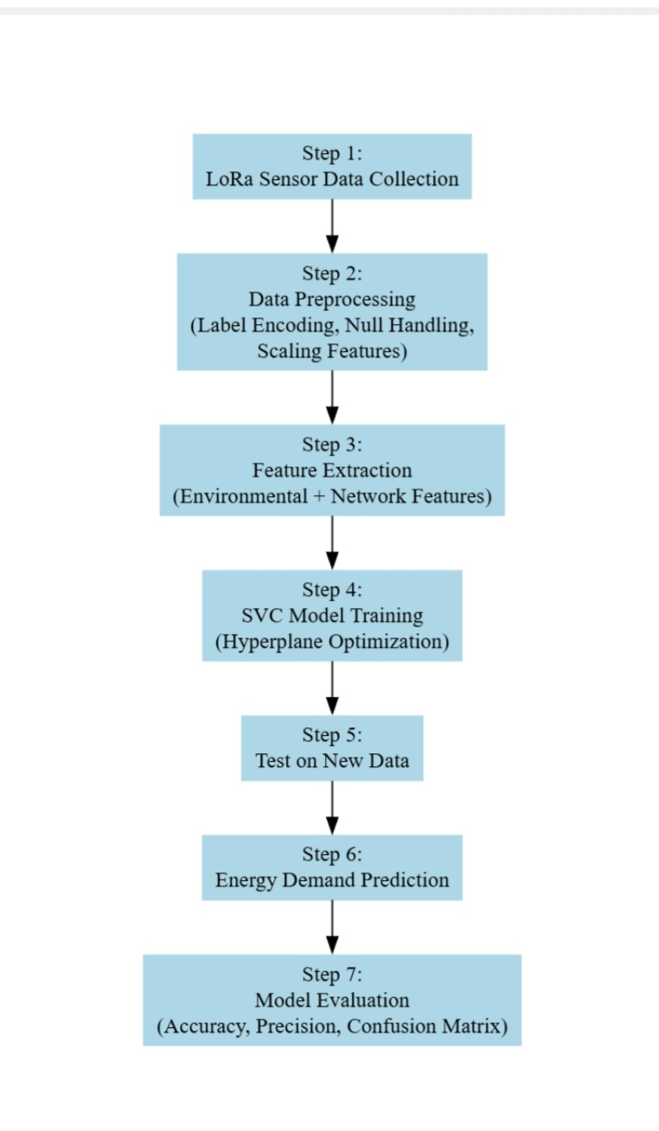
Proposed Methodology:-
In our proposed system, we first collect network parameters such as distance, remaining energy, traffic load, RSSI, and packet loss.
The dataset is preprocessed and balanced using SMOTE.
We then train machine learning models including Support Vector Machine and Random Forest.
These models predict the future energy demand of each node.
Based on predicted energy demand, routing decisions can be optimized for energy-efficient communication.

Slide 8
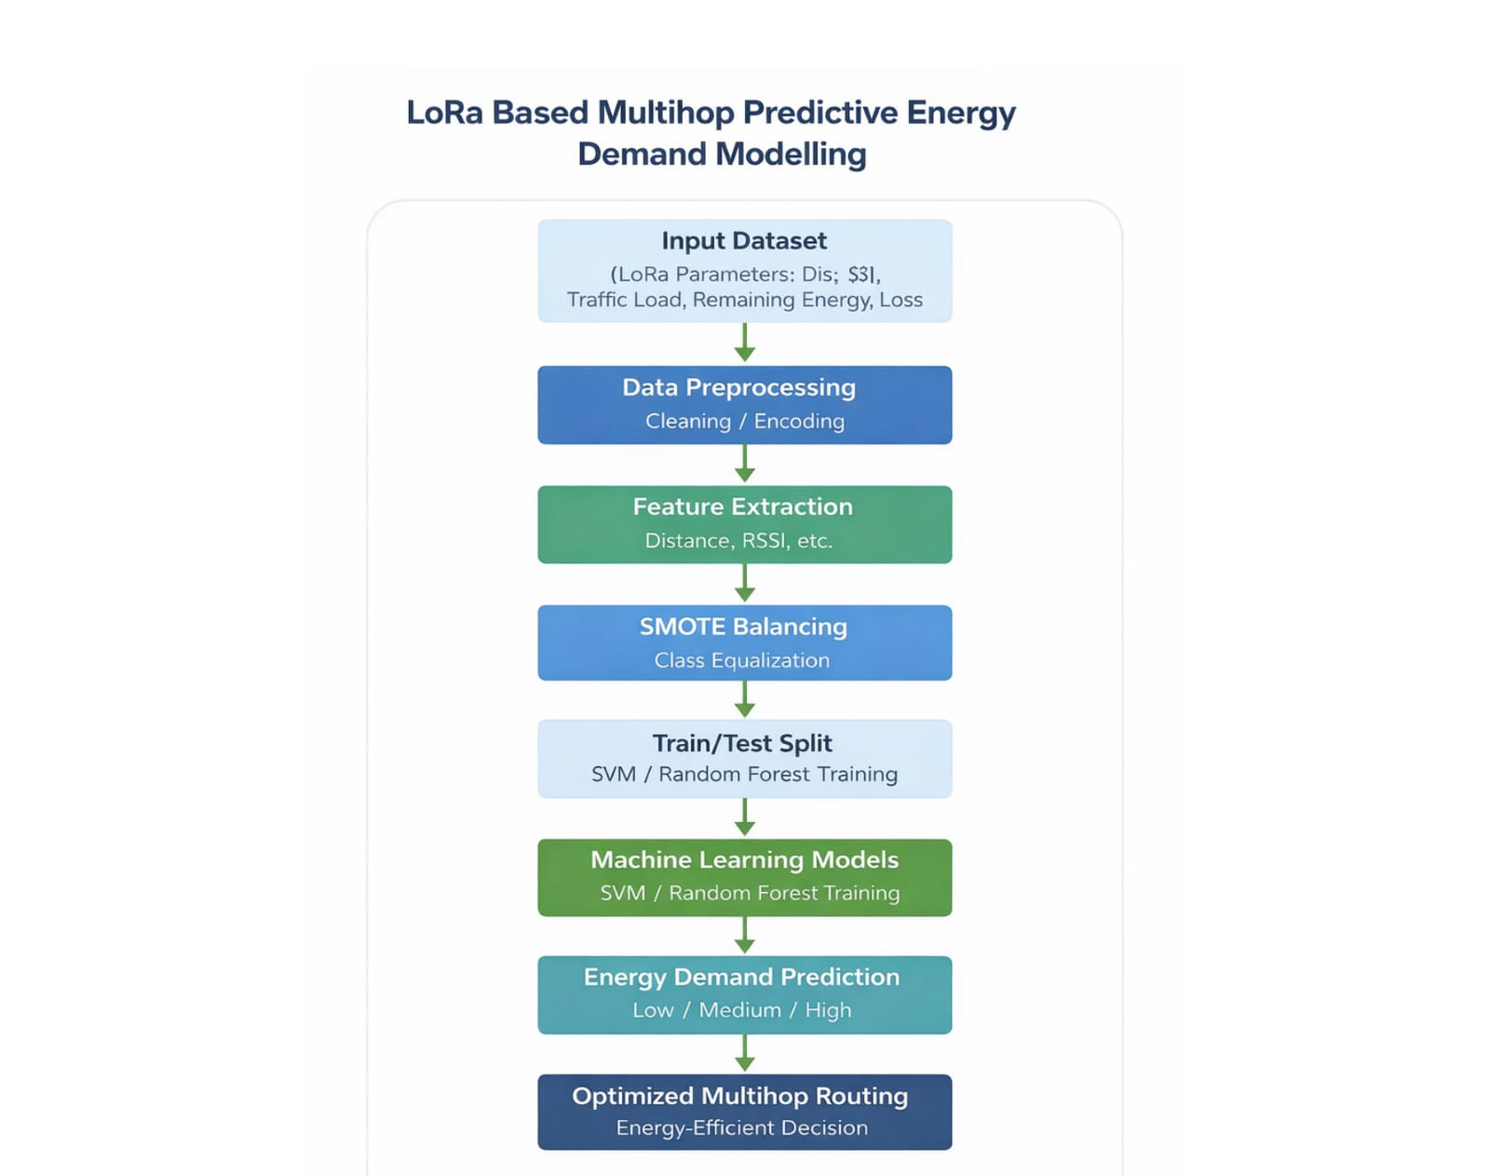
Block Diagram:-
This diagram illustrates the workflow of the proposed system, where LoRa network data is preprocessed and analyzed using machine learning models to predict energy demand. Based on the prediction, optimized multihop routing is performed for efficient wireless communication.

Slide 9
System Design:-
The system consists of multiple LoRa sensor nodes connected in a multihop network.
Sensor nodes communicate through intermediate relay nodes.
A gateway collects network data.
The machine learning prediction engine processes this data and estimates future energy demand.
Routing can then be optimized based on these predictions.

Slide 10
Hardware Deatails:-
The hardware requirements for this project include a laptop or PC for implementation.
Optionally, LoRa modules and wireless sensor nodes can be used for prototype deployment.
In our project, the implementation is simulation/software-based.

Slide 11
Software Details:-
The software tools used are Python 3.x and Visual Studio Code.
We used NumPy and Pandas for data handling,
Scikit-learn for machine learning model implementation,
and Matplotlib/Seaborn for visualization.

Slide 12
Implementation Flow:-
First, the training dataset is loaded into Python.
Then labels are encoded and the data is split into training and testing sets.
SMOTE is applied for balancing class distribution.
SVM and Random Forest models are trained.
Performance metrics are calculated.
Finally, test data is passed for energy demand prediction.

Slide 13
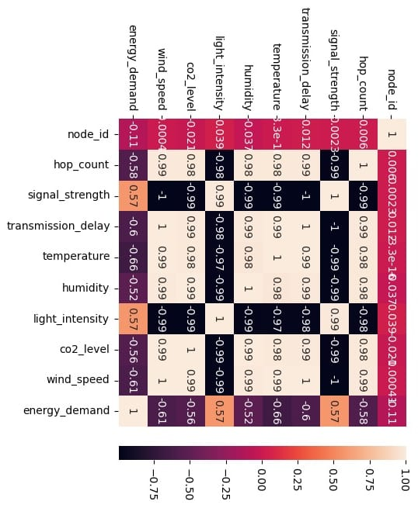
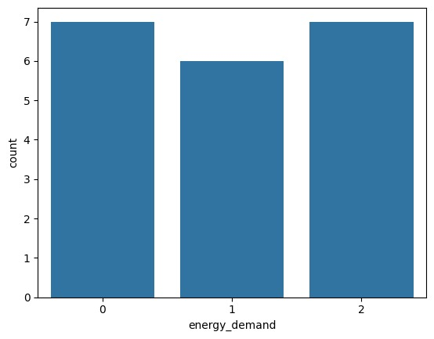
Result:-

Slide 14
Applications&Future Scope:-
->Applications
Smart Agriculture
Smart Cities
Industrial IoT
->Future Scope
Real-Time Edge Deployment
Advanced Deep learning models
Adaptive energy routing

Slide 15
Reference:-
(IEEE)
F. Adelantado et al., IEEE, 2017
A. Augustin et al., Sensors Journal, 2016
LoRa Alliance Documentation
Arduino & MATLAB Documentation

